Slide 1
Thomas SaNDBRINK
FULL STACK JAVA DEVELOPER

Slide 2

About ME

Slide 3
FAMILY

Slide 4

TRUMAN STATE UNIVERSITY
B.A., History and Classics
Class of 2014

Slide 5

WILLIAM & MARY LAW SCHOOL
J.D.
Class of 2017

Slide 6

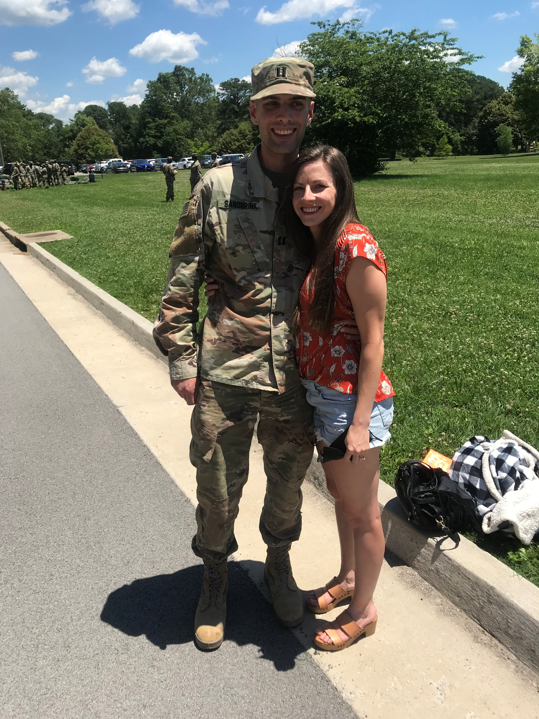
U.S. Army JAG CORPS
United States Army Cadet Command
1ST Theatre Sustainment Command
3rd Infantry Division

Slide 7
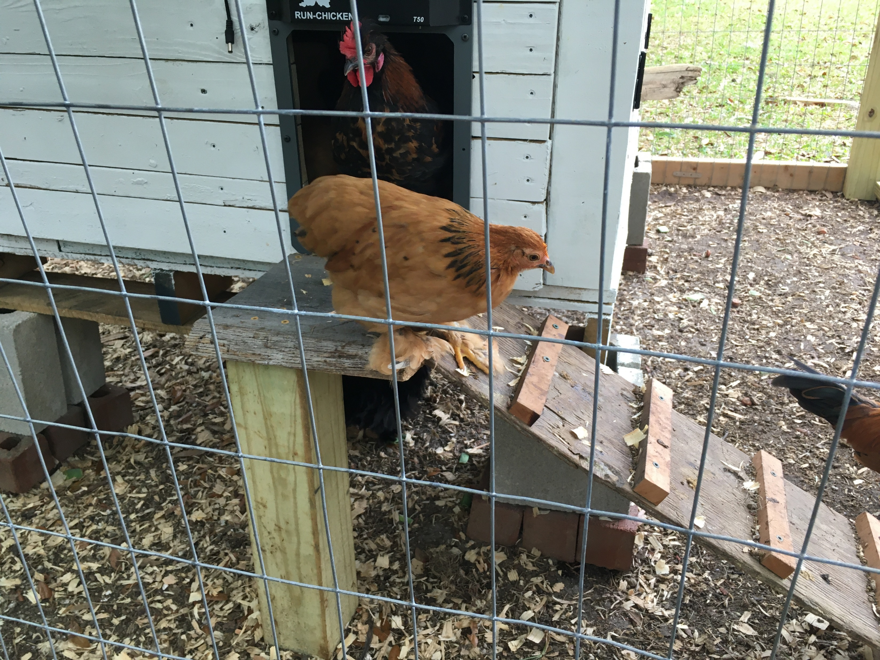
HOBBIES
Raising Backyard Chickens

Slide 8
Capstone: MYFLOCK
Problem: Keeping Track of Backyard Chicken Flock
No Data on How Many People Keep Backyard Chickens – Est. 10 – 13 million

Slide 9
Capstone: MYFLOCK
Solution: MyFlock – a Web Application To Track Your Backyard Chicken Flock

Slide 10









Technologies USED

Slide 11
Contact Information
tsandbrink123@gmail.com
636-484-3762
https://www.linkedin.com/in/thomas-sandbrink-871631253/
https://github.com/tsandbrink

